Slide 1
Title page
Name
EDUC 6301: Classroom Management
Houston Baptist University
Classroom Management Plan

Slide 2
Personal philosophy
My personal philosophy as an educator is based on the experience I deliver to my students.
I have the sole responsibility of creating a positive environment ultimate learning for all students.
I try to maintain a model of learning which engages all the students creating a sense of care and respect between me and the students as well as trying my best to understand my students.
My way of teaching is based on the positive learning environment I create for my students and giving them opportunities to have a positive learning atmosphere.
I prefer an authoritative orientation as it gives me control over my classroom and giving each student an equal opportunity to experience an enriching learning atmosphere.

Slide 3
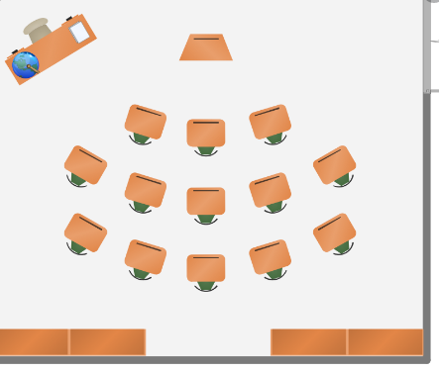
Arrangement
Teacher’s table
Maps
Shelves

Slide 4
Classroom rules
Students should always be in class on time in the morning or after breaks.
Student must respect each other , be kind as well as polite.
Assignments should always be completed on time for full marks.
Paying attention during lesson time is crucial and any student who wants to speak should be free to raise their hand. (Fraser, 2012).

Slide 5
Classroom consequences
Positive
Rewards for high marks
Enjoying privileges for good behavior
Praise
Negative
Losing marks for late assignments and homework
Punishment for unwanted behavior in classroom

Slide 6
Routines and Procedures
Settling in the classroom quietly
Turn in your assignments
No leaving classroom during lessons
Adhere to tea and lunch breaks
Clean the classroom before leaving to your homes

Slide 7
Addressing special populations
Having the students with hearing or vision problems sit at the front rows.
Use of short and understandable statements for those with intellectual disabilities.
Minimizing noise and distractions in the classroom for maximum concentration.
Promoting group interactions to increase participation of the antisocial students (Cline, & Schwartz, 1999).

Slide 8
Extrinsic motivator s
The use of rewards and prices for top performing students
Applauding and praising students who participate in class (Sansone, & Harackiewicz, (Eds.)2000).
Penalties for bad behavior in the classroom
Losing marks for assignments submitted past deadline.
Giving positive motivation to the students

Slide 9
Intrinsic motivators
Giving positive verbal feedback to questions asked by students to motivate their participation.
Acknowledging and using good students as examples for others (Sansone, & Harackiewicz, (Eds.)2000).
Allowing the students to make choices when dividing tasks to ensure maximum participation

Slide 10
Setting the tone
Being enthusiastic when interacting with the students to set a good example for them.
Having an energetic and a positive attitude when teaching to create an enriching learning environment.
Showing confidence in what I teach to improve students confidence when learning or answering questions in the classroom.
Teaching students to be supportive to each other than laughing at those who don’t know (Fraser, 2012).

Slide 11
References
Fraser, B. J. (2012). Classroom environment (Vol. 234). Routledge.
Sansone, C., & Harackiewicz, J. M. (Eds.). (2000). Intrinsic and extrinsic motivation: The search for optimal motivation and performance. Elsevier.
Cline, S., & Schwartz, D. (1999). Diverse populations of gifted children: Meeting their needs in the regular classroom and beyond. Merrill/Prentice Hall, 200 Old Tappan Road, Old Tappan, NJ 07675.

